Slide 1


Building Robust ETL Pipelines with Azure Data Factory
Mapping Data Flows with API Data

Slide 2
Notes to the Presenter
Slides 4-10 contain notes for the presenter and are hidden.
You may include your picture and company logo on one slide only
It is appropriate to provide a brief background (1 minute or less) on your organization.

Slide 3
Presentation Best Practices
Frame your presentation by answering:
What do you want your audience to learn?
What do you want your audience to do differently?
What result or outcomes do you want your audience to realize?
Clarify your session objectives at the beginning of your presentation.

Slide 4
Presentation Best Practices
A picture is worth a thousands word. A good goals is to aim for 7 words per slide.
Increase attention and interaction by using a variety of communication mediums, such as polls and videos.
Inform PowerBIUG team of plans if using videos, audio, etc. to ensure appropriate AV & room arrangements are made
Plan and follow a rough agenda including a breakdown by minute to help stay on track.

Slide 5
Example of Text Layout
Main topic 1: size 28pt
Size 24pt for the subtopics
Size 24pt for the subtopics
Main topic 2: size 28pt
Size 24pt for the subtopics
Size 24pt for the subtopics
Main topic 3: size 28pt
Size 24pt for the subtopics
Size 24pt for the subtopics

Slide 6
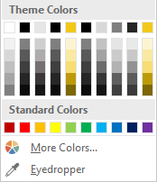
Slide Palette Info
The PowerPoint palette for this template has been built for you and is shown below. Avoid using too many colors in your presentation.
Select the 4th color from the left for subheads and 1st level non-bulleted text color, or wherever “color” text is preferred over the default black/white text
Accent colors 1-6 – (6 Theme Colors to the far right)
Text
Dark 2
Accent 1
Accent 2
Accent 3
Accent 4
Accent 5
Accent 6
Use Accent 1 as the main accent color. Use Accent 2 and Accent 3 when additional colors are needed.
Use Accents 4-6 sparingly – only when more colors are necessary.

Slide 7
Chart Example

Slide 8
Lots of data? Minimalize
Gray is used to de-emphasize data that is less important. Use cool gray 3 or cool gray 7. See slide 7 for color formulas.
All elements have the same interior margins as text blocks.
When a chart or graphic, has more elements than can easily be aligned to the grid, align the outer edges of the group, top, bottom, left and right edges to the grid.
It is preferable to keep the group aligned to the left border.
130M
140M
125M
Other
Other
Other
Other
Other
Other

Slide 9
Chart Example

Slide 10
Notes (hidden)
Some speakers at Microsoft like to use this slide for hidden “notes slides”.
Delete it if you don’t want to use it.
Next: <next slide title>

Slide 11
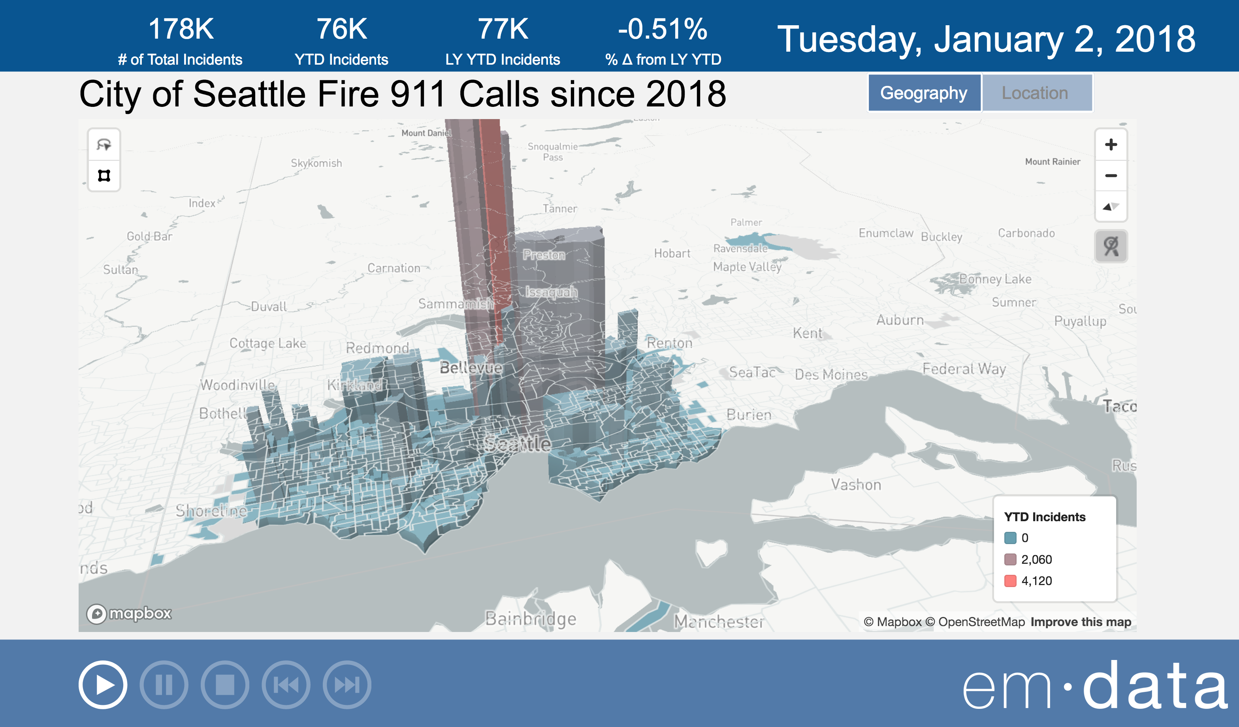

City of Seattle Fire 911 Calls

Slide 12


Tony McGovern
Hacker. Artist. Storyteller. Data lover.
Data Scientist
tony@emata.ai
emdata.ai
http://github.com/tonmcg/
@tonmcg
Notes:
Data Scientist at emdata
We love Power BI helps us easily build impactful data applications that we allow us to scale at a fraction of the time, energy, and cost
And we love working with organizations that are making a difference in the world -- for us Power BI is the way for everyone to do more, better

Slide 13
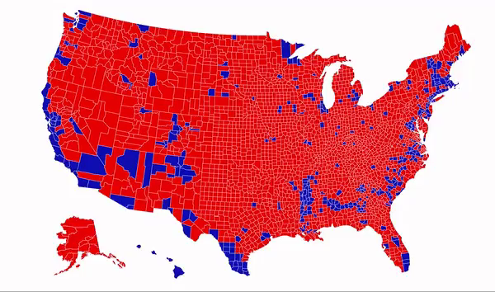
Notes:
Data Scientist at emdata
We love Power BI helps us easily build impactful data applications that we allow us to scale at a fraction of the time, energy, and cost
And we love working with organizations that are making a difference in the world -- for us Power BI is the way for everyone to do more, better

Slide 14
Azure Data Factory

Slide 15
Azure Data Factory
New Pipeline Model
Rich pipeline orchestration
Triggers – on-demand, schedule, event, tumbling window
Data Movement as a Service
Cloud, Hybrid
70+ connectors provided
Mapping and Wrangling Data Flows
Visual authoring, code-free, Azure DataBricks Compute
SSIS Package Execution
In a managed cloud environment
Use familiar tools, SSMS & SSDT
Author & Monitor
Programmability (Python, .NET, PowerShell, etc)
Visual Tools

Slide 16
Azure Data Factory
Transform Data, At Scale, in the Cloud, Zero-Code
Cloud-first, scale-out ELT
Code-free dataflow pipelines
Serverless scale-out transformation execution engine
Maximum Productivity for Data Engineers
Does NOT require understanding of Spark / Scala / Python / Java
Resilient Data Transformation Flows
Built for big data scenarios with unstructured data requirements
Operationalize with Data Factory scheduling, control flow and monitoring

Slide 17
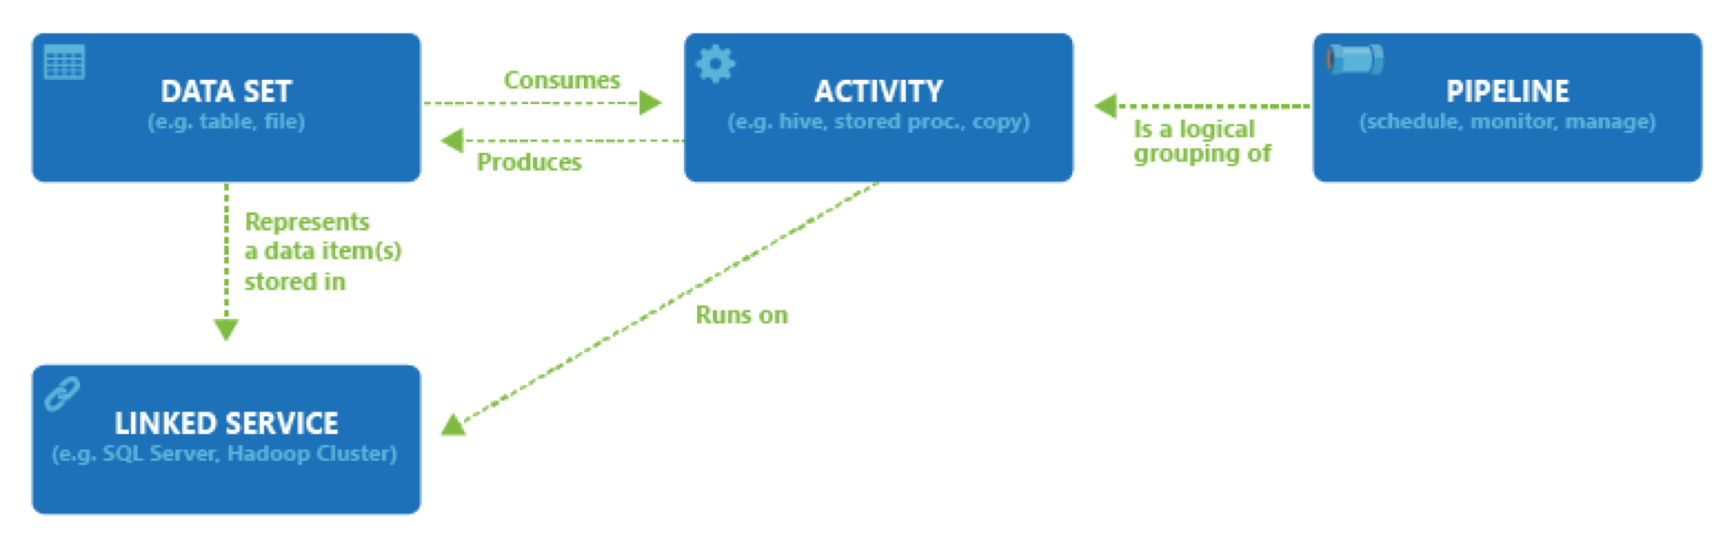
Data Flow Entities

Slide 18
Demonstration: Create Http Linked Service to Socrata API

Slide 19
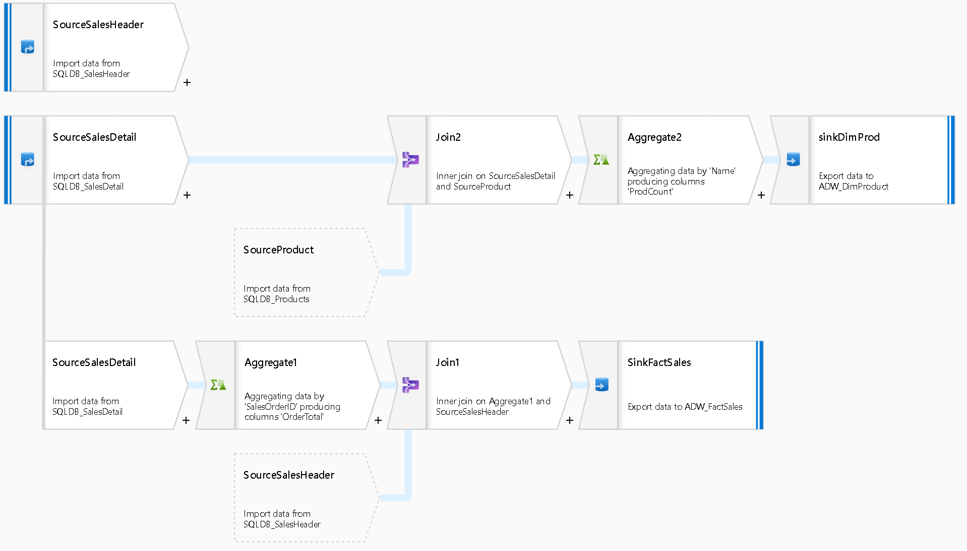
Mapping Data Flow: Load a Star Schema

Slide 20
Demonstration: Preprocess Data with Mapping Data Flow

Slide 21
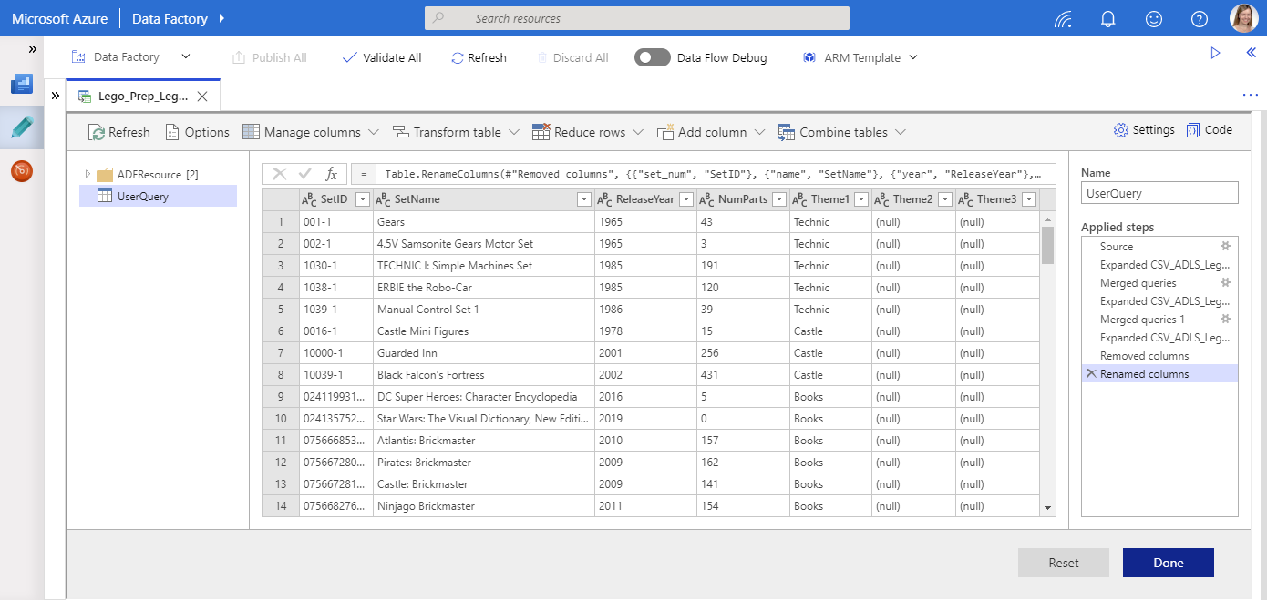

Wrangling Data Flows: The Road Ahead

Slide 22
Resources
Tutorial Videos: http://aka.ms/dataflowvideos
Patterns
http://kromerbigdata.com
http://mssqldude.wordpress.com
http://aka.ms/dataflowpatterns
Documentation: https://docs.microsoft.com/en-us/azure/data-factory/concepts-data-flow-overview
Expression Language: http://aka.ms/dataflowexpressions
Comparing Mapping and Wrangling Data Flows: https://www.cathrinewilhelmsen.net/2019/05/13/comparing-mapping-wrangling-data-flows-azure-data-factory/

